Slide 1


Minor Project
Title: Land Documentation and Registry system using Blockchain technology
Presented by:
R2142201370 - Avinash Kumar
R2142201541 - Medhavi Singh
R2142201488 - Rohan Chauhan
R2142201937 - Rohit Sharma
Mentored By
Dr. Ambika Aggarwal

Slide 2
Content
Introduction
Literature Review
Objectives
Methodology
References

Slide 3
Introduction
Technical Concepts used
Decentralized Ledger: A decentralized ledger is a type of digital ledger that is distributed across a network of computers, rather than being maintained by a central authority. This means that no single entity controls the information recorded on the ledger, making it more secure and transparent.
Smart Contracts: A smart contract is a program that runs on the blockchain network and is stored on every node. They automate the process of verifying and executing the terms of the contract, making it possible to enforce, validate, and negotiate digital agreements without the need for intermediaries.
Blockchain: Blockchain is a decentralized, digital ledger that records transactions across a network of computers. Each block in the chain contains a record of multiple transactions, and once added to the chain, the data in the block is considered tamper-proof and permanent.
Cryptography: Cryptography is the practice of secure communication in the presence of third parties, called adversaries. It involves transforming information into an unreadable format, called ciphertext, to prevent unauthorized parties from accessing the original data, called plaintext.

Slide 4
Introduction
Motivation
Improved security
Transparency
Better accessibility
Decentralization
Reduce the chances of frauds in the processes
Reducing mutation time
Cost Saving

Slide 5
Introduction
Problem Statement
Although the traditional registry systems are self-sufficient to an extent for accurate and secure Land Documentation and Registry, we often see certain inefficiencies, errors, and fraud in these methods which leads to delays and higher costs in the land transaction process. Hence a solution for this is the use of blockchain technology that can improve the accuracy, transparency as well as security of Land Documentation and Registry systems.

Slide 6
Introduction
Area of Application
Property Registration: Create a secure and transparent database of property ownership and transactions.
Real-estate related transactions: To record and manage real estate transactions
Property/Land Management: Used to record and manage information related to a particular land.
Property title Management: Used to securely store and manage land titles and ownership.

Slide 7
Literature Review
Inference from Literature Review
The traditional land registration systems frequently face some problems such as fraud, inaccuracies, and lack of transparency which causes inefficiencies and delays in the transaction process of the property.[5] Blockchain technology offers a clear solution to these problems by providing a decentralized, secure, and transparent ledger for recording and managing all the information related to land.
There are many benefits of using blockchain for land registration system. One benefit is definitely increased security and better accuracy because of the decentralized nature of blockchain. Another benefit is the transparency in the process.
However, there might be several challenges in the implementation of this technology. One challenge is the need for legal frameworks that support the use of blockchain technology for land registry purposes.[4] Another challenge might be the resistance from users who are used to traditional land registry systems as they may be doubtful of new technology.
In conclusion, blockchain technology has the potential to transform Land Documentation and Registry systems by providing various benefits such as increased security, accuracy and transparency.

Slide 8
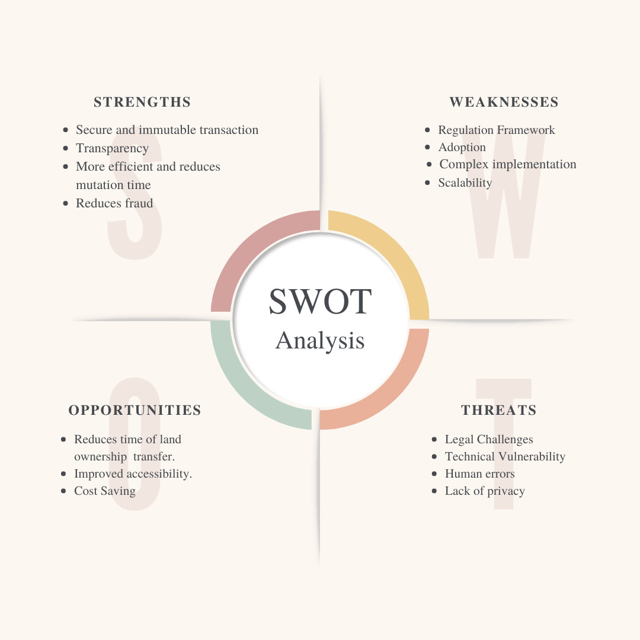
Literature Review
SWOT analysis

Slide 9
Objective
Main Objective
To explore the benefits of using blockchain technology for Land Documentation and Registry systems.
To create more efficient, secure, and transparent Land Documentation and Registry systems.
To overcome the inefficiencies, and errors and reduce the chances of fraud in the traditional registry systems.

Slide 10
Methodology
Reference Software model
This project is based on Incremental process Model or successive version model. In the start a Minimal viable product will be developed with few basic functionality and will be considered as the backbone of the further advancements in the project.
Steps
Ethereum as the blockchain platform.
As a programming language, we will be using solidity for writing smart contracts.
Use of React, JavaScript, and Node.js for the backend and frontend development.
We will be using PostgreSQL for the database.
Git version control system and GitHub for collaboration.

Slide 11
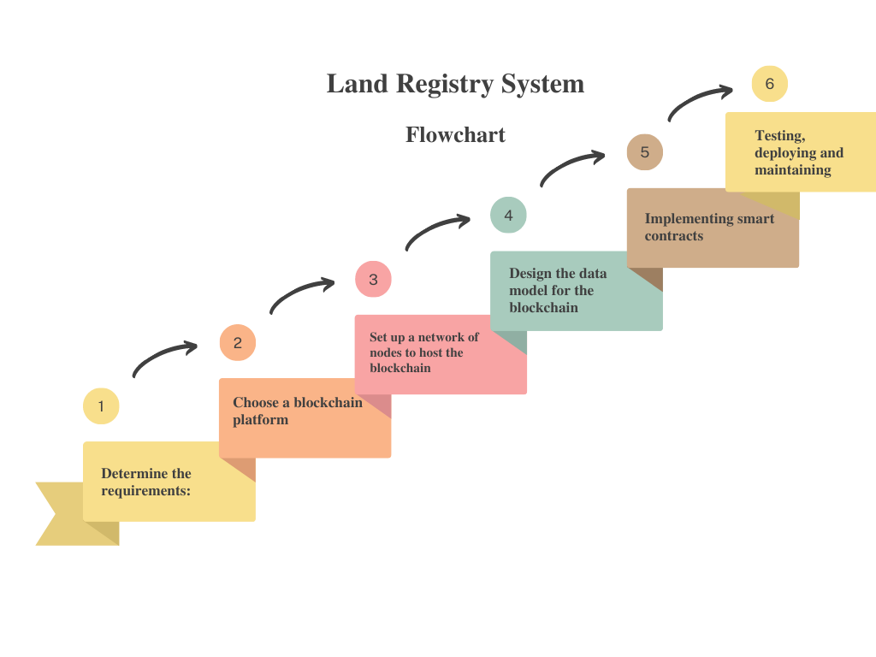
Flowchart

Slide 12
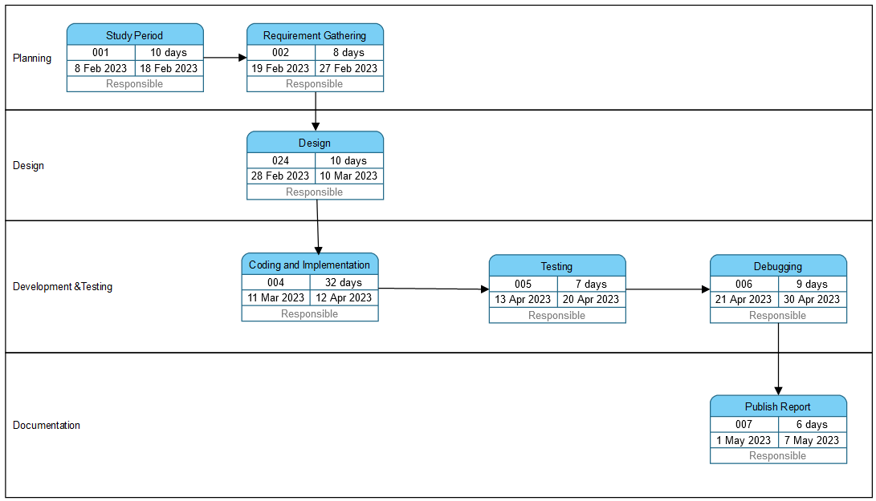
Methodology
Timeline

Slide 13
Reference
List of cited papers
[1] J. Vos, "Blockchain-based land registry: panacea illusion or something in between?," IPRA/CINDER congress, Dubai, 2016.
[2] R. Benbunan-Fich, A. Castellanos, "Digitization of Land Records: From Paper to Blockchain," Thirty Ninth International Conference on Information Systems, 2018
[3] Kshetri, N. (2017). Blockchain-based secure and transparent land registry. Government Information Quarterly, 34(4), 669-676.
[4] S, Krishnapriya & Sarath, Greeshma. (2020). Securing Land Registration using Blockchain. Procedia Computer Science. 171. 1708-1715. 10.1016/j.procs.2020.04.183.
[5] M. Nandi, R. K. Bhattacharjee, A. Jha and F. A. Barbhuiya, "A secured land registration framework on Blockchain," 2020 Third ISEA Conference on Security and Privacy (ISEA-ISAP), Guwahati, India, 2020, pp. 130-138, doi: 10.1109/ISEAISAP49340.2020.235011
[6] Blockchain-based framework for secure and reliable land registry system Article in TELKOMNIKA (Telecommunication Computing Electronics and Control) · October 2020

Slide 14
Thank You

